Slide 1
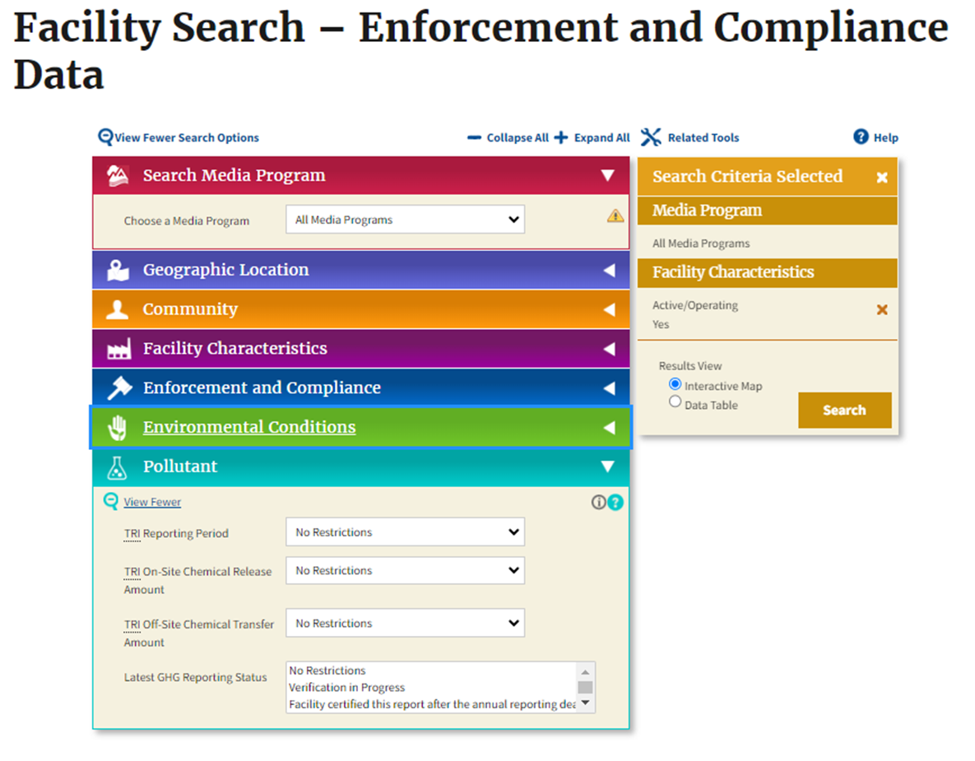
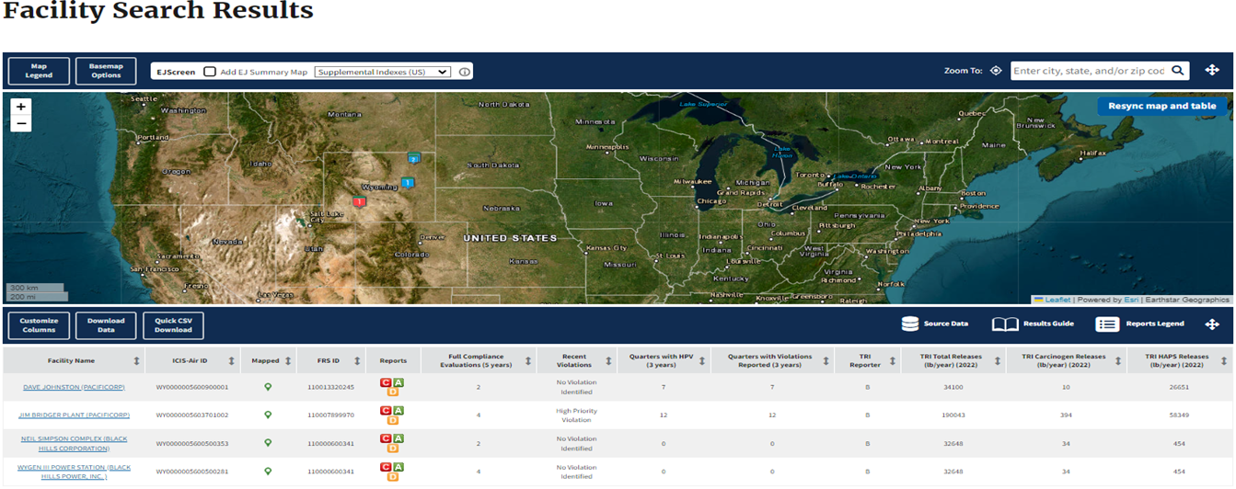
EPA’s Facility Search Tool offers multiple ways to find facilities that submit to TRI:
Facility Search: Search Facilities for TRI information TRI by various media program, such as Air, Drinking Water, Water / Stormwater / Biosolid, & Hazard Waste.
Facility Search Pollutant Report: The TRI Facility search can be customized by TRI Reporting Period, TRI On-Site Chemical Release Amount, TRI Off-Site Chemical Transfer Amount, & Latest GHG Reporting Status.
Facility TRI Report: Detailed Facility report can be available along with TRI History and Inventory Report.
1) First, Search:
Using ECHO Facility Search to find the TRI Program data and information you need is easy! All you need to do is:
1) Search,
2) Sort, and
3) Drill Down!
2) Then, Sort:
https://echo.epa.gov

Slide 2
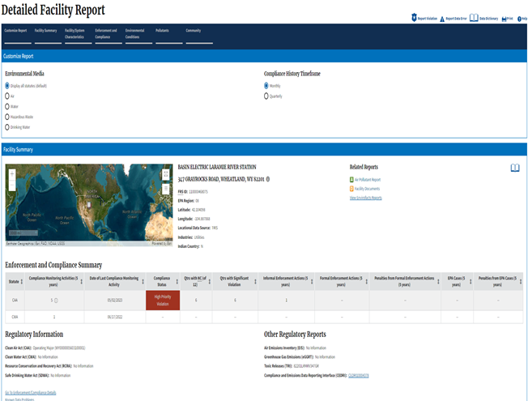
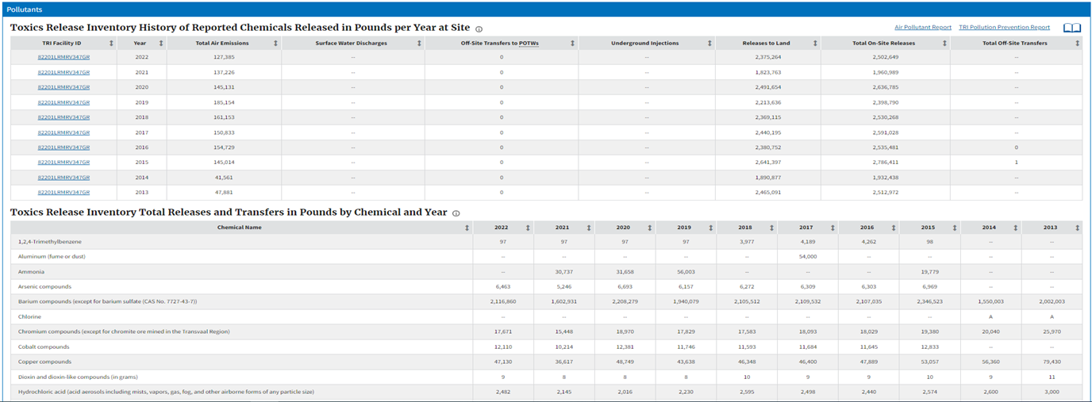
EPA’s Facility Search Tool offers multiple ways to search Facilities for TRI Program information:
Facility Search: Search by Facilities with current Violation’s, Facilities with Violation’s, Facilities with Formal Enforcement Actions, Facilities with Informal Enforcement Actions, & Facilities with Significant Violations
Facility Search Report: The Data table Facility Search provides a high-level overview of TRI Report, TRI Carcinogen Releases (ID/ Year), & TRI HAPS Release (ID/ Year)
3) Then, Drill Down:
https://echo.epa.gov

