Slide 1
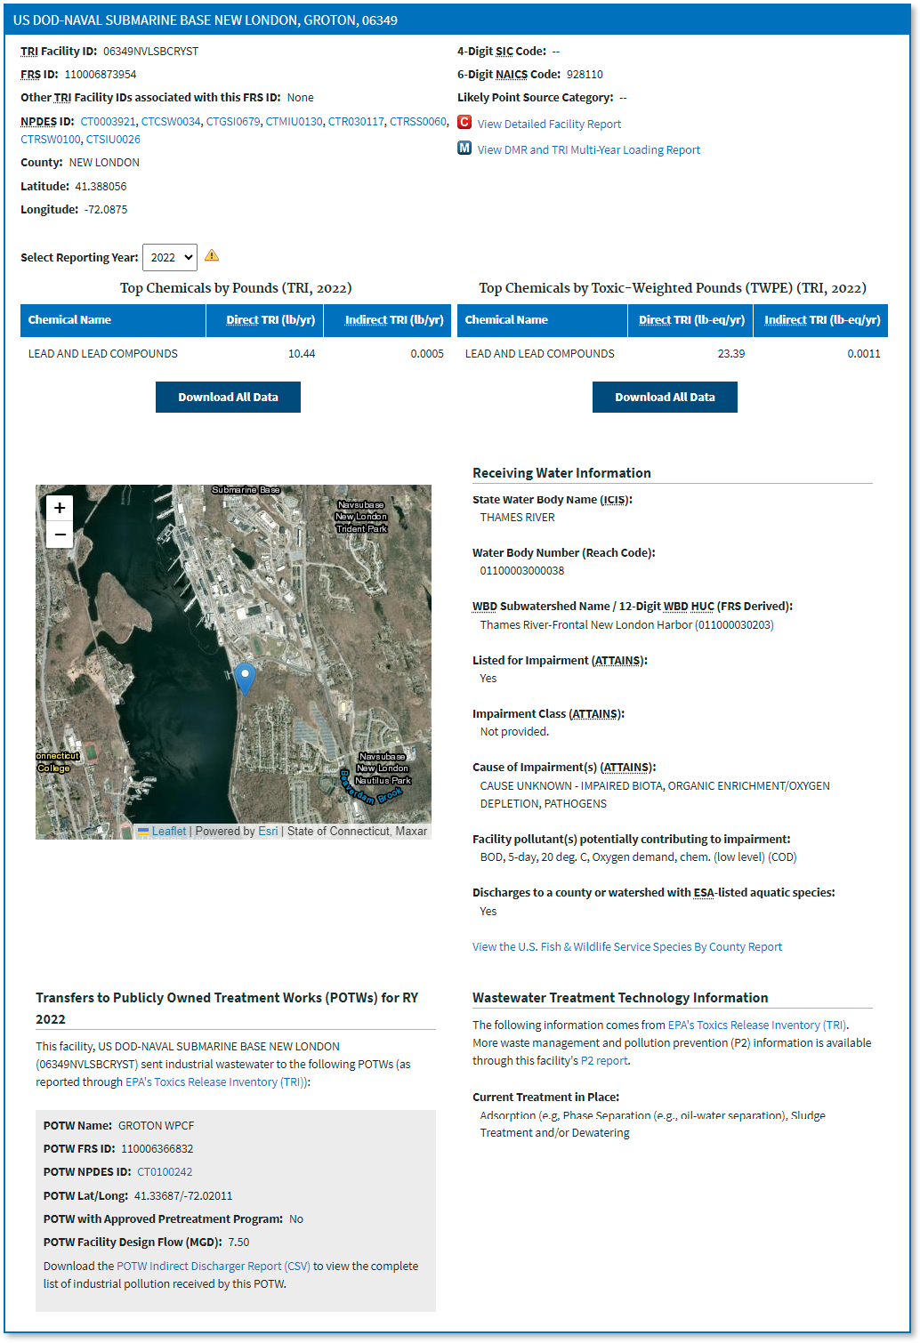
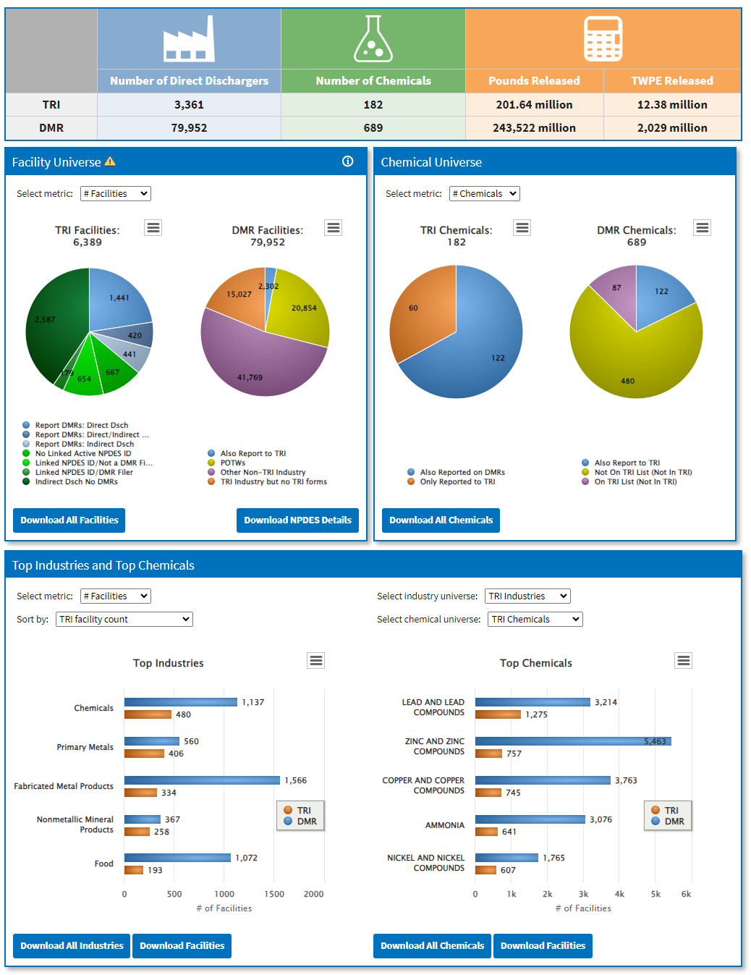
EPA’s Water Pollutant Loading Tool offers multiple TRI data analysis tools
TRI Search: Search by location, pollutant, industry, and watershed to quickly identify the largest water releases
TRI Pollutant Loading Report: View detailed information about TRI water releases for a facility, and related information such as receiving water, transfers to POTWs, and wastewater treatment technologies
TRI and DMR Comparison Dashboard: Use the side-by-side TRI and DMR data comparisons to review data quality, analyze compliance, and understand sources of water releases
Multi-year Loading Report: Analyze TRI and DMR data trends over time for a facility
Additional Resources: Access reference tables for TRI Chemicals, POTW removals, crosswalks linking TRI and DMR facilities and chemicals, and a tutorial series on comparing TRI and DMR data
https://echo.epa.gov

Slide 2
EPA’s Water Pollutant Loading Tool combines Toxic Release Inventory (TRI) and Discharge Monitoring Report (DMR) data to provide a more complete picture of water releases
Industrial User: Water transfers to POTWs captured in TRI
Wastewater Treatment Plant (POTW): Surface water releases captured in DMRs
Industrial Point Source: Surface water releases captured in both TRI and DMRs
A
C
B
https://echo.epa.gov

